Slide 1

Lument
Finance Trust
Q1 2024 Earnings Supplemental
May 2024

Slide 2
Disclaimer
This presentation contains forward-looking statements within the meaning of Section 27A of the Securities Act of 1933, as amended, and Section 21E of the Securities Exchange Act of 1934, as amended, which reflect the current views of Lument Finance Trust, Inc. (NYSE: LFT) (“LFT,” the “Company,” “we,” “our,” or “us”) with respect to, among other things, the Company’s operations and financial performance. You can identify these forward-looking statements by the use of words such as “outlook,” “indicator,” “believes,” “expects,” “potential,” “continues,” “may,” “will,” “should,” “seeks,” “approximately,” “predicts,” “projects,” “intends,” “plans,” “estimates,” or “anticipates,” or the negative version of these words or other comparable words or other statements that do not relate strictly to historical or factual matters. Such forward-looking statements are subject to various risks and uncertainties. Accordingly, there are or will be important factors that could cause actual outcomes or results to differ materially from those indicated in these statements. The Company believes these factors include but are not limited to those described under the section entitled “Risk Factors” in its Annual Report on Form 10-K for the year ended December 31, 2023, which is available on the SEC’s website at www.sec.gov. These factors should not be construed as exhaustive and should be read in conjunction with the other cautionary statements that are included in this presentation and in the filings. The forward-looking statements contained in this presentation speak only as of May 9th, 2024. The Company assumes no obligation to update or supplement forward‐looking statements that become untrue because of subsequent events or circumstances.
This presentation includes non-GAAP financial measures, including Distributable Earnings. While we believe the non-GAAP information included in this presentation provides supplemental information to assist investors in analyzing our operating results and to assist investors in comparing our operating results with other peer issuers, these measures are not in accordance with GAAP, and they should not be considered a substitute for, or superior to, our financial information calculated in accordance with GAAP. Please refer to this presentation’s Appendix for a reconciliation of the non-GAAP financial measures included in this presentation to the most directly comparable financial measures prepared in accordance with GAAP.

Slide 3

Company Overview
The Company is an externally-managed real estate investment trust focused on investing in, financing and managing a portfolio of commercial real estate debt investments.
The Company is externally managed by Lument Investment Management LLC, an affiliate of
ORIX Corporation USA.
Key Investment Highlights
Strong Sponsorship/Ownership
Attractive Investment Profile
Access to extensive loan origination platform through affiliation with Lument, a premier national mortgage originator and asset manager.
Experienced management team with an average of 20+ years of industry experience across multiple economic cycles.
Affiliation with ORIX Corporation USA, the US subsidiary of ORIX Corporation, the publicly traded Tokyo-based international financial services firm.
Emphasis on middle market multifamily debt investments which are well positioned for the current environment.
Strong credit and asset management capabilities.
Attractive financing source via match term, non-recourse, non mark-to-market, collateralized financing structures.

Slide 4
Q1 2024 Updates
Financial Results | Q1 2024 GAAP net income attributable to common stockholders of $0.11 per share of common stock. Q1 2024 Distributable Earnings⁽¹⁾ of $0.15 per share of common stock. On March 15, 2024, the Company declared a cash dividend for the quarter of $0.07 per share of common stock. The Company also declared a cash dividend for the quarter of $0.49219 per share of 7.875% Cumulative Redeemable Series A Preferred Stock. Q1 2024 Book Value Per Share of Common Stock of $3.50⁽²⁾.
Notable Activity | During the quarter, the Company experienced $97.4 million of loan payoffs.
Portfolio Performance | As of March 31, 2024, the Company’s investment portfolio consisted of floating-rate CRE loans of which approximately 93.6%⁽³⁾ were collateralized by multifamily assets. As of March 31, 2024, the Company’s $1.3 billion loan portfolio had a weighted average remaining term of 11 months⁽⁴⁾, a weighted average interest rate of SOFR + 3.60%, and unamortized purchase discounts of $6.3 million. The weighted average risk rating of the portfolio remained unchanged from the prior quarter at 3.5, with 76.9% of the portfolio rated “3” (Moderate Risk) or better. No asset-specific reserves were recorded during the period.
Capitalization | The floating-rate CRE loan portfolio is financed primarily through the Company’s two outstanding non-mark-to-market secured financings: $762.5 million of investment grade notes issued through LMNT 2021-FL1. $317.7 million of investment grade notes issued through LMF 2023-1. As of March 31, 2024, the Company held cash and cash equivalents of $64.6 million with a leverage ratio of 4.7x, a decrease of 0.3x from 5.0x in the prior quarter. No corporate debt maturities until 2026.
Note: (1) We believe that Distributable Earnings provides meaningful information to consider in addition to our net income (loss) and cash flows from operating activities determined in accordance with GAAP. Distributable Earnings mirrors how we calculated Core Earnings in the past. Please see Appendix for reconciliation to GAAP.
(2) See Appendix for definition of Book Value Per Share of Common Stock.
(3) Based on carrying value.
(4) If all extensions are exercised by the borrowers, the CRE loan portfolio will have a weighted average remaining term of 33 months.

Slide 5
Q1 2024 Balance Sheet Summary
Balance Sheet (thousands) | March 31, 2024⁽¹⁾
Commercial mortgage loans held-for-investment (net of allowance for credit losses) | $1,285,479
Cash and cash equivalents | 64,573
Restricted cash⁽²⁾ | 72
Accrued interest receivable | 8,463
Investment related receivable | 17,320
Other assets⁽³⁾ | 2,284
Total assets | $1,378,192
Secured financings⁽⁴⁾ | $1,075,890
Credit facility⁽⁴⁾ | 47,282
Other liabilities | 12,084
Total liabilities | $1,135,257
Total equity | $242,935
Total liabilities / total equity | 4. 7x
Book Value Per Share of Common Stock⁽⁵⁾ | $3.50
Note: (1) See Appendix for detailed consolidated balance sheet, including the Company’s consolidated variable interest entities (“VIE’s”).
(2) Restricted cash held by LMF 2023-1 is available for investment in eligible mortgage assets.
(3) Includes mortgage servicing rights, carried at fair value of $0.7 million.
(4) Outstanding principal amount of investment grade notes issued by LMNT 2021-FL1 and LMF 2023-1 is $762.5 million and $317.7 million, respectively. The unpaid principal balance of the credit facility is $47.8 million. For GAAP purposes, these liabilities are carried at their outstanding unpaid principal balance, net of any unamortized discounts and debt issuance costs.
(5) See Appendix for definition of Book Value Per Share of Common Stock.

Slide 6
Q1 2024 Income Statement Summary
Summary Income Statement (thousands) | Three Months Ended March 31, 2024
Net interest income | $12,993
Total other income (loss) | (1,734)
Operating expenses | (4,268)
Benefit (provision) from income taxes | (11)
Preferred dividends | (1,185)
Net income attributable to common stockholders | $5,795
Weighted average shares outstanding during the period, basic and diluted | 52,249,299
Net income attributable to common stockholders per share | $0.11
GAAP Net Income to Distributable Earnings Reconciliation (thousands) | Three Months Ended March 31, 2024
Net Income attributable to common stockholders | $5,795
Adjustments:
Unrealized (gains) losses on mortgage servicing rights | (5)
Unrealized provision for credit losses | 1,777
Provision for (benefit from) income taxes | 11
Distributable Earnings⁽¹⁾ | $7,578
Weighted average shares outstanding during the period, basic and diluted | 52,249,299
Distributable Earnings per share of common stock | $0.15
Dividend per share of common stock | $0.07
Note: (1) See Appendix for definition of Distributable Earnings and reconciliation to GAAP.

Slide 7
Earnings and Book Value Per Share of Common Stock
Distributable Earnings⁽¹⁾ &
Dividends Per Share of Common Share
Book Value Per Share of Common Stock⁽²⁾
Note: (1) See Appendix for definition of Distributable Earnings.
(2) See Appendix for definition of Book Value Per Share of Common Stock.

Slide 8
Investment Portfolio
On March 31, 2024, the Company owned a portfolio of floating-rate CRE loans with a carrying value of $1.3 billion. 93.6%⁽¹⁾ of the portfolio was invested in loans collateralized by multifamily assets.
The Company anticipates that it will continue to focus on investment opportunities within multifamily credit. The Company does not currently own any hospitality, retail, or office loan assets and has limited exposure to seniors housing and self-storage.
Geographic Concentration⁽²⁾
Property Type⁽²⁾
$1,285.5
$1,285.5
Note: (1) Based on carrying value.
(2) $ In millions, based on carrying value.

Slide 9
Q1 2024 Loan Activity
The Company experienced $97.4 million of loan payoffs during the quarter.
Q1 Payoffs by Property Type⁽¹⁾
Portfolio Activity⁽²⁾
$97.4
Note: (1) $ In millions, based on carrying value.
(2) Portfolio balances shown based on carrying value net of allowances. “Other Activity” consists of the accrued deferred origination fees and purchase discount accretion.

Slide 10
Portfolio Credit
As of March 31, 2024, 97.1% of the Company’s portfolio was performing⁽¹⁾, with 76.9% of the portfolio rated “3” (Moderate Risk) or better.
Weighted average risk rating⁽²⁾ of 3.5 remained unchanged quarter over quarter.
Asset Performance⁽¹⁾
Weighted Average Risk Rating⁽²⁾
Note: (1) An asset is defined as performing if it is not in default, or not on non-accrual status.
(2)Weighted average risk rating is weighted based on carrying value of portfolio assets.

Slide 11
Q1 2024 Capital Structure Overview
The Company does not currently utilize repurchase or warehouse facility financing and therefore is not subject to margin calls on any of its assets from repo or warehouse lenders.
Primary sources of financing include two secured financings (LMNT 2021-FL1 and LMF 2023-1), preferred stock, and a corporate term loan.
Capital Structure Composition⁽¹⁾
Capital Structure Detail
Match Term
Non-Recourse
Financing
Note: (1) In millions. LFT total capitalization is a non-GAAP measure which excludes certain Balance Sheet items; Please see Appendix for reconciliation to GAAP.
(2) Secured financing shown at par value. LMNT 2021-FL1 GAAP carrying value of $761.3 million includes $1.3 million of unamortized debt issuance costs. LMF 2023-1 carrying value of $314.6 million includes $3.1 million of unamortized debt issuance costs.
(3) Term loan shown at par value. GAAP carrying value of $47.3 million includes $0.5 million of unamortized debt issuance costs.
(4) Preferred equity shown at $60 million liquidation preference.
(5) Noncontrolling interest was $99,500 as of 3/31/2024 and is excluded from common equity above.

Slide 12
Net Interest Income Sensitivity to Shifts in Term SOFR
100% floating-rate loan portfolio.
100% of portfolio is indexed to 30-day term SOFR⁽¹⁾.
Floating-Rate Exposure⁽²⁾
Net Interest Income Per Share
Sensitivity to Change in SOFR⁽⁵⁾
Note: (1) The Company converted its LIBOR-based loans and CLO liabilities to term SOFR on July 6th, 2023.
(2) In millions. Net Exposure represents UPB of floating rate portfolio assets net of par value of secured floating rate debt outstanding.
(3) Figure reflects unpaid principal balance of floating-rate loan portfolio.
(4) Comprised of outstanding securitization notes related to 2021-FL1 and LMF 2023-1, both of which are indexed to one-month SOFR. Figure reflects par value of notes.
(5) Annualized impact per common share. Assumes starting 30-day term SOFR of 5.31%.

Slide 13
Appendix

Slide 14
3/31/2024 CRE Loan Portfolio Details
Continued on the following page
Note: (1) LTV as of the date the loan was originated by an affiliate. LTV has not been updated for any subsequent draws or loan modifications and is not reflective of any changes in value which may have occurred subsequent to the origination date.

Slide 15
3/31/2024 CRE Loan Portfolio Details
Continued on the following page
Note: (1) LTV as of the date the loan was originated by an affiliate. LTV has not been updated for any subsequent draws or loan modifications and is not reflective of any changes in value which may have occurred subsequent to the origination date.

Slide 16
3/31/2024 CRE Loan Portfolio Details
Continued on the following page
Note: (1) LTV as of the date the loan was originated by an affiliate. LTV has not been updated for any subsequent draws or loan modifications and is not reflective of any changes in value which may have occurred subsequent to the origination date.

Slide 17
3/31/2024 CRE Loan Portfolio Details
Note: (1) LTV as of the date the loan was originated by an affiliate. LTV has not been updated for any subsequent draws or loan modifications and is not reflective of any changes in value which may have occurred subsequent to the origination date.

Slide 18
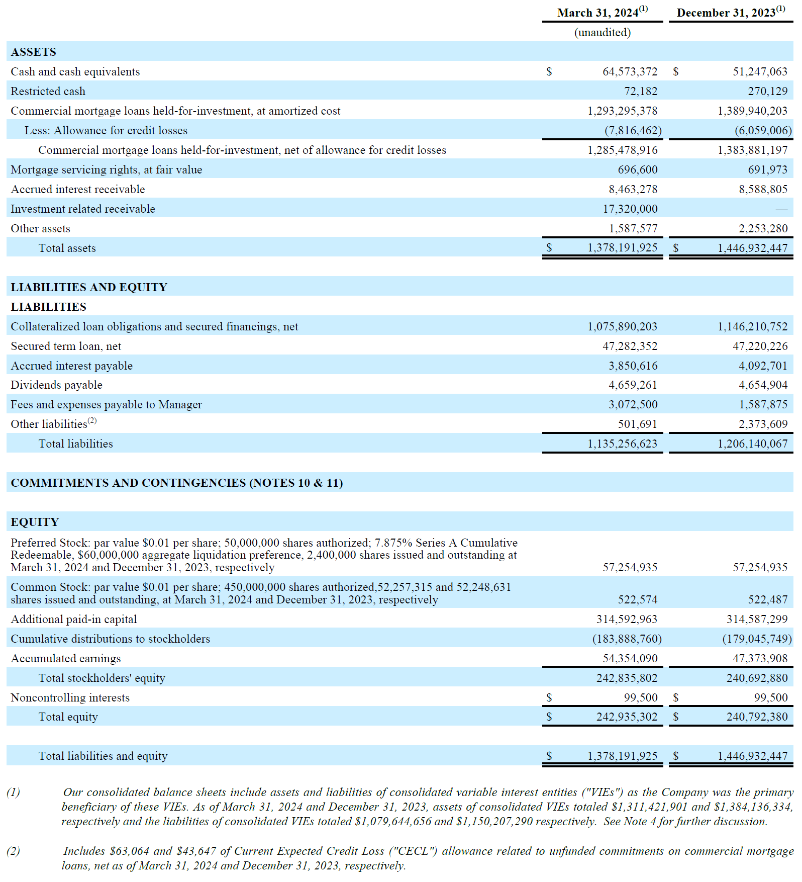
Consolidated Balance Sheets

Slide 19
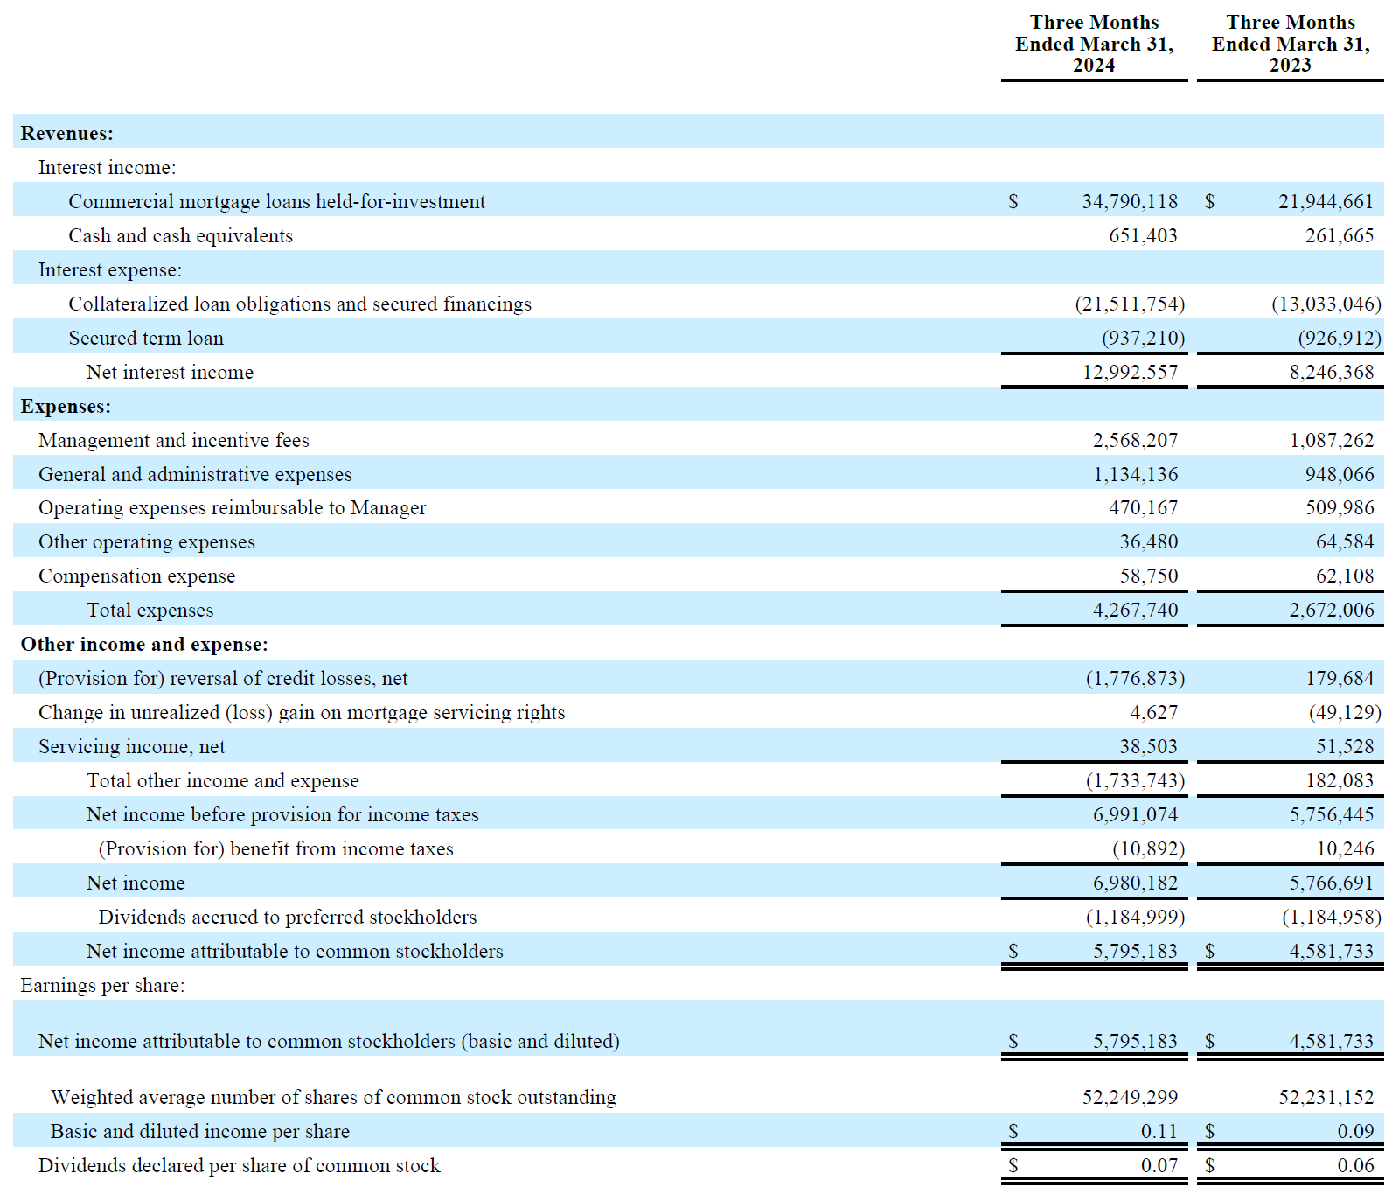
Consolidated Statement of Income

Slide 20
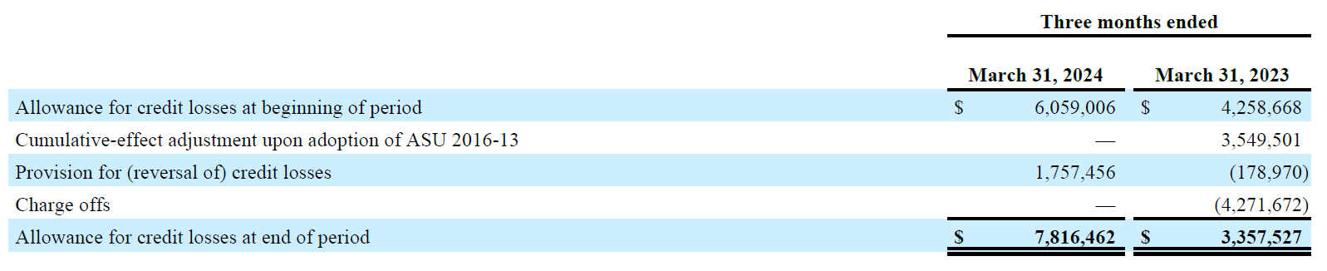
Detailed Walk of Allowance for Loan Losses

Slide 21
Reconciliation of Net Income to Distributable Earnings
 | For the Three Months Ended
GAAP to Distributable Earnings Reconciliation | March 31, 2024 | December 31, 2023 | September 30, 2023 | June 30, 2023
Reconciliation of GAAP to non-GAAP Information
Net income attributable to common stockholders | $5,795,183 | $3,828,893 | $5,174,685 | $1,389,185
Adjustments for non-Distributable earnings
Unrealized losses (gains) on mortgage servicing rights | (4,627) | 56,334 | (1,573) | (206)
Unrealized provision for credit losses | 1,776,873 | 1,357,254 | 791,563 | 555,083
Subtotal | 1,772,246 | 1,413,588 | 789,990 | 554,877
Other Adjustments
Recognized compensation expense related to restricted common stock | - | - | - | 2,836
Adjustment for income taxes | 10,892 | (4,057) | 19,803 | 223
Subtotal | 10,892 | (4,057) | 19,803 | 3,059
Distributable Earnings | $7,578,321 | $5,238,424 | $5,984,478 | $1,947,121
Weighted average shares outstanding, basic and diluted | 52,249,299 | 52,231,722 | 52,231,152 | 52,231,152
Distributable Earnings per share of common stock, basic and diluted | $0.15 | $0.10 | $0.11 | $0.04

Slide 22
Detailed Walk of Capitalization as of 3/31/2024
(in 000's) | 3/31/2024
Total GAAP liabilities and stockholders' equity | $1,378,092
Adjustments for Capitalization
( - ) Accrued interest payable | (3,851)
( - ) Dividends payable | (4,659)
( - ) Fees and expenses payable to Manager | (3,073)
( - ) Other accounts payable and accrued expenses | (502)
( + ) Other capitalized financing & issuance costs | 4,823
LFT Capitalization | $1,370,832

Slide 23
Book Value Per Share of Common Stock as of 3/31/2024
(in 000's) | Book Value per Share of Common Stock
Total stockholders’ equity | $242,935
( - ) Preferred equity⁽¹⁾ | (60,000)
( - ) Non-controlling interest | (100)
Common equity | $182,836
Shares outstanding | 52,257,315
Book Value Per Share of Common Stock | $3.50
Note: (1) Reflects 2.4 million shares of the Company’s 7.875% Series A Cumulative Redeemable Preferred Stock outstanding at a $25 liquidation preference per share.

Slide 24
Key Definitions
“Book Value Per Share of Common Stock” is calculated as: a) total stockholders’ equity computed in accordance with GAAP less the value of the issued and outstanding preferred stock at its stated liquidation preference of $25.00 per share, divided by b) the weighted average number of shares of common stock issued and outstanding during the period, basic and diluted.
“Distributable Earnings” is a non-GAAP measure, which we define as GAAP net income (loss) attributable to holders' of common stock, or, without duplication, owners of the Company's subsidiaries, computed in accordance with GAAP, including realized losses not otherwise included in GAAP net income (loss) and excluding (i) non-cash equity compensation, (ii) depreciation and amortization, (iii) any unrealized gains or losses or other similar non-cash items that are included in net income for that applicable reporting period, regardless of whether such items are included in other comprehensive income (loss) or net income (loss), and (iv) one-time events pursuant to changes in GAAP and certain material non-cash income or expense items after discussions with the Company's board of directors and approved by a majority of the Company's independent directors. We also add back one-time charges such as acquisition costs and one-time gains/losses on the early extinguishment of debt and redemption of preferred stock. Distributable Earnings mirrors how we calculate Core Earnings pursuant to the terms of our management agreement between our Manager and us, or our Management Agreement, for purposes of calculating the incentive fee payable to our Manager. While Distributable Earnings excludes the impact of any unrealized provisions for credit losses, any loan losses are charged off and realized through Distributable Earnings when deemed non-recoverable. Non-recoverability is determined (i) upon the resolution of a loan (i.e. when the loan is repaid, fully or partially, or in the case of foreclosures, when the underlying asset is sold), or (ii) with respect to any amount due under any loan, when such amount is determined to be non-collectible.
We believe that Distributable Earnings provides meaningful information to consider in addition to our net income (loss) and cash flows from operating activities determined in accordance with GAAP. We believe Distributable Earnings is a useful financial metric for existing and potential future holders of our common stock as historically, over time, Distributable Earnings has been a strong indicator of our dividends per share. As a REIT, we generally must distribute annually at least 90% of our taxable income, subject to certain adjustments, and therefore we believe our dividends are one of the principal reasons stockholders may invest in our common stock. Refer to Note 16 to our consolidated financial statements for further discussion of our distribution requirements as a REIT. Furthermore, Distributable Earnings help us to evaluate our performance excluding the effects of certain transactions and GAAP adjustments that we believe are not necessarily indicative of our current loan portfolio and operations and is a performance metric we consider when declaring our dividends.
Distributable Earnings does not represent net income (loss) or cash generated from operating activities and should not be considered as an alternative to GAAP net income (loss), or an indication of GAAP cash flows from operations, a measure of our liquidity, or an indication of funds available for our cash needs. In addition, our methodology for calculating Distributable Earnings may differ from the methodologies employed by other companies to calculate the same or similar performance measures, and accordingly, our reported Distributable Earnings may not be comparable to the Distributable Earnings reported by other companies.

Slide 25
May 2024

