Slide 1
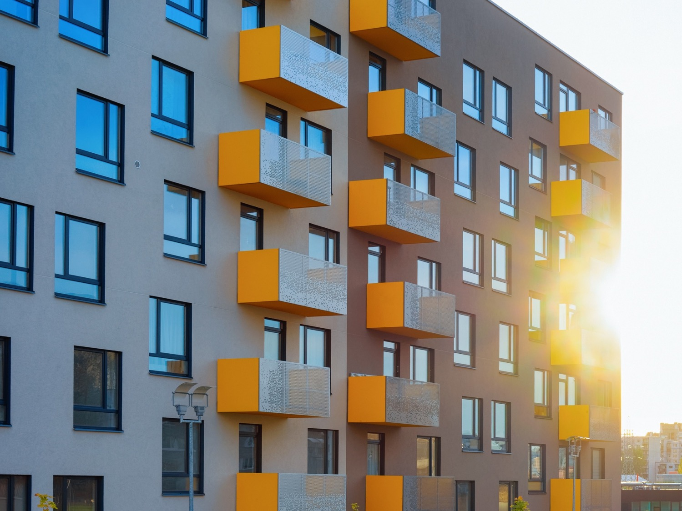
Lument
Finance Trust
Investor Presentation
March 2022

Slide 2
Disclaimer
This presentation, any related webcast/conference call, and other oral statements made by our representatives from time to time may constitute forward-looking statements within the meaning of Section 27A of the Securities Act of 1933, as amended, and Section 21E of the Securities Exchange Act of 1934, as amended, which reflect the current views of Lument Finance Trust, Inc. (NYSE: LFT) (“LFT” or the “Company”) with respect to, among other things, the Company’s operations and financial performance. You can identify these forward-looking statements by the use of words such as “outlook,” “indicator,” “believes,” “expects,” “potential,” “continues,” “may,” “will,” “should,” “seeks,” “approximately,” “predicts,” “projects,” “intends,” “plans,” “estimates,” “anticipates” or the negative version of these words or other comparable words. Such forward-looking statements are subject to various risks and uncertainties. Accordingly, there are or will be important factors that could cause actual outcomes or results to differ materially from those indicated in these statements. The Company believes these factors include but are not limited to those described under the section entitled “Risk Factors” in its Annual Report for fiscal year 2021 on Form 10-K and other periodic filings with the Securities and Exchange Commission (“SEC”), when evaluating these forward-looking statements. Additionally, many of these risks and uncertainties are currently amplified by and will continue to be amplified by, or in the future may be amplified by, the COVID-19 outbreak. It is not possible to predict or identify all such risks. Additional information concerning these and other risk factors are contained in our 2021 Form 10-K which is available on the SEC’s website at www.sec.gov. These factors should not be construed as exhaustive and should be read in conjunction with the other cautionary statements that are included in this presentation and in the filings. The Company assumes no obligation to update or supplement forward‐looking statements that become untrue because of subsequent events or circumstances
This presentation includes non-GAAP financial measures within the meaning of Item 10(e) of Regulation S-K, as promulgated by the SEC. While we believe the non-GAAP information included in this presentation provides supplemental information to assist investors in analyzing our financials and to assist investors in comparing our results with other peer issuers, these measures are not in accordance with GAAP, and they should not be considered a substitute for, or superior to, our financial information calculated in accordance with GAAP. Our GAAP financial results and the reconciliations from these results contained herein should be carefully evaluated

Slide 3

Company Overview
The Company is an externally-managed real estate investment trust focused on investing in, financing and managing a portfolio of commercial real estate debt investments
The Company is externally managed by Lument Investment Management, an affiliate of
ORIX Corporation USA
Key Investment Highlights
Strong Sponsorship/Ownership
Attractive Investment Profile
Access to extensive loan origination platform through affiliation with Lument, a premier national mortgage originator and asset manager
Experienced management team with average of 23 years of industry experience across multiple economic cycles
Affiliation with ORIX Corporation USA, the US subsidiary of ORIX Corporation, a publicly traded Tokyo-based international financial services firm
Emphasis on middle market multifamily investments which are well positioned for the current environment
Strong credit and asset management capabilities with zero delinquencies or monetary defaults during the COVID era
Attractive financing source via non-recourse, non mark-to-market CRE CLO
Notes:
Top table off print screen from REINS team as of Nov 2020
Second table off print screen from Corp Dev team as of 12/16/20 – stated “23 yrs avg experience” in 2020 Tokyo deck

Slide 4
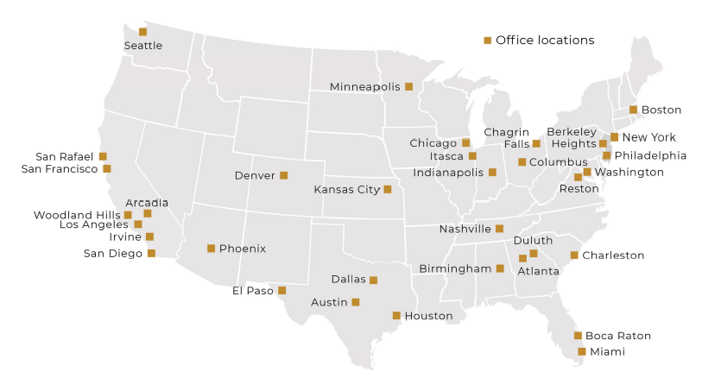
Leveraging the Depth of the Lument Platform
The Company leverages Lument’s broad platform and significant expertise when originating
and underwriting investments
Lument is a nationally recognized leader in multifamily and seniors housing and care finance
Combining the industry expertise of legacy brands Hunt Real Estate Capital, RED Capital Group, and Lancaster Pollard, Lument offers a comprehensive set of custom capital solutions to its clients across commercial real estate with a strong focus in multifamily, affordable housing, and seniors housing and healthcare
Significant Multifamily Expertise
Top 10 non-bank multifamily lender
$50 billion servicing portfolio (as of December 31, 2021)
Lument’s combined predecessor companies rank first in HUD senior housing and healthcare lending over the past decade, with more than 1,000 closings totaling over $8.6 billion
Top 5 Fannie Mae Small Loan lender (2021)
Top 3 Freddie Mac Small Loan Lender (2021)
Top ranked FHA MAP lender
Notes:
4th bullet in slide per FHA seniors group

Slide 5
Lument: A Platform Built for the Benefit of Investors
Diverse Opportunity Set via Lument Origination Platform | 600+ employees across 30+ offices provide clients of Lument and its affiliates with a mix of markets, assets, and deal types that span the breadth of commercial and multifamily real estate Majority of deals are directly originated which creates differentiated access to investment opportunities
Proprietary Underwriting and Proactive Surveillance | Seasoned underwriting staff analyze opportunities on a deal-by-deal basis, and are further supported by a proprietary database of more than 20,000 deals “Boots-on-the-ground” approach to underwriting, surveillance, and asset management allows for: Real-time intelligence that helps inform investment process Enhanced view of trends and warning signals across markets and asset types Lument’s $50 billion servicing portfolio⁽¹⁾ includes a Fitch-rated servicing unit
Cradle-to-Grave Capital Source | Robust borrower relationships combined with an efficient underwriting process allows Lument to be a go-to capital provider, which in turn keeps the Company’s pipeline of investment opportunities active and diverse Flexibility to act as a capital provider up and down the capital stack both reinforces value to borrower clients and offers a multitude of investment opportunities to the Company
Backing from Well-Capitalized Parent Company | Backing from ORIX Corporation USA, an established international parent ORIX Corporation (TSE: 8591 and NYSE: IX) operates in 28 countries and regions In-house operations, asset management, legal, compliance, HR, etc.
Note: (1) As of December 31, 2021.

Slide 6
Affiliation with ORIX
ORIX Corporation USA, a subsidiary of ORIX Corporation, is the parent of the Company’s investment manager and is also a meaningful Company shareholder
ORIX CORPORATION USA – AT A GLANCE
ORIX Corporation USA provides investment capital and asset management services to clients in the corporate, real estate and municipal finance sectors. ORIX USA and its family of companies have $85 billion of assets under management, administration and servicing as of December 2021. ORIX USA and its subsidiaries include a team of more than 1,300 employees spanning more than 30 offices across the U.S. and Brazil. Its parent company, ORIX Corporation, is a publicly owned, Tokyo-based international financial services company:
Global Reach
Operating in 28 countries and regions
More than 2,100 locations
Ranked No. 292 on 2020 Forbes Global 2000: World’s Largest
Public Companies
Publicly Traded
Listed on the Tokyo (8591) and
New York (NYSE: IX) stock exchanges
Approximately $24 billion market capitalization as of December 2021
Capital Reach
Balance sheet assets exceeding $124 billion (As of December 2021)
Approximately $469 billion in assets under management across the globe (As of December 2021)
Rated
Long-term debt credit rating of A- by S&P’s, Fitch’s and A3 by Moody’s (As of end of December 2021)

Slide 7

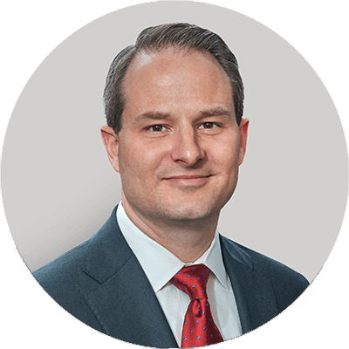






Lument: Experienced Leadership Team
JAMES FLYNN
MIKE LARSEN
JAMES BRIGGS
PRECILLA TORRES
Director & CEO, Lument Finance Trust Chief Executive Officer, Lument
President, Lument Finance Trust Chief Operating Officer, Lument
CFO, Lument Finance Trust Chief Accounting Officer, Lument
Head of Real Estate Investment Strategies, Lument
VIC CLARK
BARRY FULLER
PHIL GIBSON
JAMES HENSON
Head of Conventional Multifamily Production, Lument
Head of Loan Servicing and Asset Management, Lument
Chief Credit Officer, Real Estate Investment Strategies, Lument
General Counsel, Lument

Slide 8
Lument Finance Trust: Target Investments
Loan Size | $5 million to $50+ million
Collateral | Primarily first lien real estate debt on stabilized or transitional assets
Property Type | Multifamily, retail, office, industrial, and self storage
Geographies | Within the United States
Loan to Value | Typically up to 80% LTC / up to 75% of stabilized value
Rate | SOFR/LIBOR + 3.00% and higher
Term | 3 to 5 years
Amortization | Typically interest only
Recourse | Typically non-recourse except for standard carve-outs

Slide 9
Lument Finance Trust: Investment Portfolio
At December 31, 2021, the Company owned a portfolio of floating-rate CRE loans with a carrying value of $1.0 billion. 92%⁽¹⁾ of the portfolio was invested in loans backed by multifamily assets
The Company anticipates that the majority of loan activity will continue to be related to multifamily assets. The Company does not own any hospitality assets and has limited exposure to retail, office, and self-storage assets (less than 10% of portfolio)
During the “COVID era,” the Company has not granted a single forbearance nor has it experienced a single monetary loan default
Geographic Concentration⁽²⁾
Property Type⁽²⁾
$1,001.8
$1001.8
Note: (1) Based on carrying value.
(2) $ In millions, based on carrying value.

Slide 10
Lument Finance Trust: Capital Structure Overview
The Company does not currently utilize repurchase or warehouse facility financing and therefore is not subject to margin calls on any of its assets from repo or warehouse lenders
Primary sources of financing include a match-term non-MTM CRE CLO (LMNT 2021-FL1), preferred stock and a corporate term loan
Capital Structure Composition
Capital Structure Detail
Match Term
Non-Recourse
Financing
Subsequent to year-end 2021, the Company raised approximately $81.1 million of net proceeds and issued 27.3 million new shares of common stock via a transferable rights offering. After the impact of this transaction, the Company’s total shares outstanding was 52.2 million, total book equity was $250.5 million, total common book value was $190.4 million and book value per share of common stock was $3.65
Note: (1) CLO financing shown at par value. GAAP carrying value of $826.8 million includes $7.0 million of unamortized debt issuance costs for LMNT 2021-FL1.
(2) Term loan shown at par value. GAAP carrying value of $46.8 million includes $0.9 million of unamortized debt issuance costs.
(3) Preferred equity shown at $60 million liquidation preference.
(4) Noncontrolling interest was $99,500 as of 12/31/2021 and is excluded from common equity above.
(5) LFT total capitalization is a non-GAAP measure which excludes certain Balance Sheet items; Please see Appendix for reconciliation to GAAP.

Slide 11
Track Record of EPS Growth and Book Value Stability
GAAP Earnings & Distributable Earnings⁽¹⁾ Per Share of Common Stock
Book Value Per Share of Common Stock⁽²⁾
Note: (1) See Appendix for definition of Distributable Earnings and reconciliation to GAAP.
(2) See Appendix for definition of Book Value Per Share of Common Stock.

Slide 12
Conclusion
Key Investment Highlights
Strong Sponsorship/Ownership
Attractive Investment Profile
Access to extensive loan origination platform through affiliation with Lument, a premier national mortgage originator and asset manager
Experienced management team with average of 23 years of industry experience across multiple economic cycles
Affiliation with ORIX Corporation USA, an established international financial firm
Emphasis on middle market multifamily investments which are well positioned for the current environment
Strong credit and asset management capabilities with zero delinquencies or monetary defaults during the COVID era
Attractive financing sources via non-recourse, non mark-to-market CRE CLOs

Slide 13
Appendix
Q4 2021
Financial
Updates

Slide 14
Full Year 2021 Business Update
Portfolio | 100% of the loans in our CRE investment portfolio were current as of as of 12/31/21
Highlights | Increased size of the CRE investment portfolio by 83% from $547 million as of 12/31/20 to $1.0 billion as of 12/31/21 Achieved a dividend coverage ratio of 108% for the full year on a distributable EPS basis Continued to demonstrate strong asset performance with zero delinquencies, monetary defaults, or impairments in the investment portfolio Maintained multifamily investment focus, increasing multifamily investment exposure from 90% as of 12/31/20 to 92% as of year-end 12/31/21 Raised $58.1 million of preferred equity via successful offering of 2.4 million shares of 7.875% Series A Cumulative Redeemable Preferred Stock at $25.00 per share Successfully closed a $1.0 billion commercial real estate collateralized loan obligation (“LMNT 2021-FL1”) and redeemed all outstanding bonds of two prior CRE CLOs in conjunction with the transaction Subsequent to year-end 2021, the Company raised approximately $81.1 million of net proceeds and issued 27.3 million new shares of common stock via a transferable rights offering. After the impact of this transaction, the Company’s total shares outstanding was 52.2 million, total book equity was $250.5 million, total common book value was $190.4 million and book value per share of common stock was $3.65 Gained incremental sell-side equity research coverage during the year
Lending Environment | The bridge loan market in 2021 featured robust activity that supported elevated multifamily acquisition transaction volume during the period. As of year-end, our Manager and its affiliates continued to control a healthy pipeline of deal flow going into 2022

Slide 15
Q4 2021 Updates
Financial Results | Q4 2021 GAAP net income attributable to common stockholders of $2.5 million, or $0.10 per share of common stock. FY 2021 net income attributable to common stockholders of $7.4 million, or $0.30 per share of common stock Q4 2021 Distributable Earnings⁽¹⁾ of $2.6 million, or $0.11 per share of common stock. FY 2021 Distributable Earnings of $9.7 million or $0.39 per share of common stock Q4 2021 Book Value Per Share of Common Stock of $4.38⁽²⁾
Highlights | During Q4 2021, the Company acquired $336.2 million of new loans at a weighted average interest rate of L + 3.21% and a weighted average LIBOR floor of 0.12%. 100%⁽³⁾ of the new acquisitions were loans backed by multifamily assets. The Company experienced $137.1 million of loan payoffs during the quarter For the full year 2021, the Company acquired and/or funded $983.7 million of new loans and participations at a weighted average spread of LIBOR + 3.46% and a weighted average LIBOR floor of 0.46%
Investment Portfolio Overview | As of December 31, 2021, 99.9%⁽³⁾ of LFT’s investment portfolio consisted of floating-rate CRE loans. 91.9%⁽³⁾ of the portfolio was multifamily. The $1.0 billion CRE loan portfolio had a weighted average remaining term of 24 months⁽⁴⁾, a weighted average interest rate of L + 3.41% and a weighted average LIBOR floor of 0.49%
Capitalization | The floating-rate CRE loan portfolio is financed with $833.8 million of investment grade notes issued through LMNT 2021-FL1, a CRE CLO
Note: (1) We believe that Distributable Earnings provides meaningful information to consider in addition to our net income (loss) and cash flows from operating activities determined in accordance with GAAP. Distributable Earnings mirrors how we calculated Core Earnings in the past. Please see Appendix for reconciliation to GAAP.
(2) See Appendix for definition of Book Value Per Share of Common Stock.
(3) Based on carrying value.
(4) If all extensions are exercised by the borrowers, the CRE loan portfolio will have a weighted average remaining term of 45 months.

Slide 16
Q4 and Full Year 2021 Income Statement Summary
Summary Income Statement (thousands) | Three Months Ended December 31, 2021 | Twelve Months Ended December 31, 2021
Net interest income | $6,174 | $20,679
Total other income (loss) | 6 | (1,633)
Operating expenses | (2,407) | (8,441)
Benefit (provision) from income taxes | (109) | (78)
Preferred dividends | (1,185) | (3,113)
Net income attributable to common stockholders | $2,479 | $7,414
Weighted average shares outstanding during the period, basic and diluted | 24,947,883 | 24,945,824
Net income attributable to common stockholders per share | $0.10 | $0.30
GAAP Net Income to Distributable Earnings Reconciliation (thousands) | Three Months Ended December 31, 2021 | Twelve Months Ended December 31, 2021
Net Income attributable to common stockholders | $2,479 | $7,414
Adjustments:
Unrealized losses on mortgage servicing rights | 56 | 357
Loss on extinguishment of debt | 0 | 1,664
Purchase premium payoffs | 0 | 151
Recognized compensation expense related to restricted stock | 5 | 16
Adjustment for income taxes | 109 | 78
Distributable Earnings⁽¹⁾ | $2,649 | $9,680
Weighted average shares outstanding during the period, basic and diluted | 24,947,883 | 24,945,824
Distributable Earnings per share of common stock | $0.11 | $0.39
Dividend per share of common stock | $0.09 | $0.36
Note: (1) See Appendix for definition of Distributable Earnings and reconciliation to GAAP.

Slide 17
Q4 2021 Balance Sheet Summary
Balance Sheet (thousands) | December 31, 2021⁽¹⁾
Commercial mortgage loans held-for-investment | $1,001,825
Cash and cash equivalents | 14,749
Restricted cash⁽²⁾ | 3,530
Accrued interest receivable | 3,978
Investment Related Receivable | 22,400
Other assets⁽³⁾ | 2,441
Total assets | $1,048,923
Collateralized loan obligations⁽⁴⁾ | $826,783
Credit facility⁽⁴⁾ | 46,846
Other liabilities | 5,920
Total liabilities | $879,548
Total equity | $169,375
Total liabilities / total equity | 5.19x
Book Value Per Share of Common Stock⁽⁵⁾ | $4.38
Note: (1) See Appendix for detailed consolidated balance sheet, including the Company’s consolidated variable interest entities (“VIE’s”).
(2) Restricted cash held by LMNT 2021-FL1, the Company’s CRE CLO, and available for investment in eligible mortgage assets.
(3) Includes mortgage servicing rights, carried at fair value of $552k
(4) Outstanding notional amount of bonds issued by LMNT 2021-FL1 is $833.8 million, and the unpaid principal balance of the credit facility is $47.8 million. For GAAP purposes, these liabilities are carried at their outstanding unpaid principal balance, net of any unamortized discounts and debt issuance costs.
(5) See Appendix for definition of Book Value Per Share of Common Stock.

Slide 18
Q4 2021 Balance Sheet Summary
The CRE loan portfolio increased by $198.8 million in Q4 2021
We acquired $336.2 million of loans at par from an affiliate of the Manager and we experienced $137.5 million of loan payoffs
Net Funding Activity^{(1,2)}
Q4 2021 Loan Acquisitions and Fundings^{(1,2)}
$336.2
Note: (1) $ In millions.
(2) Based on carrying value.

Slide 19
Interest Rate Sensitivity as of December 31, 2021
Floating-Rate Exposure
Annual Net Interest Income Sensitivity to Shifts in One-Month LIBOR^{(3,4,5)}
$ in Millions
Note: (1) Comprised of the Company’s portfolio of floating-rate CRE loans.
(2) Comprised of outstanding securitization notes in the CRE CLO.
(3) Assumes starting one-month LIBOR rate of 0.10125%.
(4) Negative LIBOR will not have further impacts on P&L.
(5) Our net interest income currently benefits from in-the-money LIBOR floors in our loan portfolio; this benefit is expected to decrease as LIBOR increases.

Slide 20
12/31/2021 CRE Loan Portfolio Details
Continued on the following page
Note: (1) LTV as of the date the loan was originated by an affiliate. LTV has not been updated for any subsequent draws or loan modifications and is not reflective of any changes in value which may have occurred subsequent to the origination date.

Slide 21
12/31/2021 CRE Loan Portfolio Details
Note: (1) LTV as of the date the loan was originated by an affiliate. LTV has not been updated for any subsequent draws or loan modifications and is not reflective of any changes in value which may have occurred subsequent to the origination date.

Slide 22
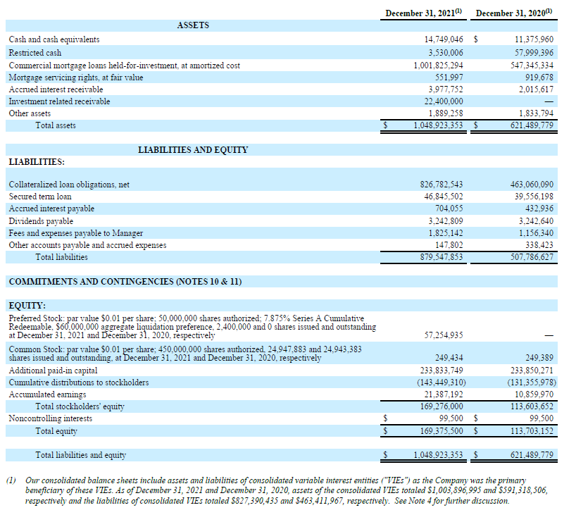
Consolidated Balance Sheets

Slide 23
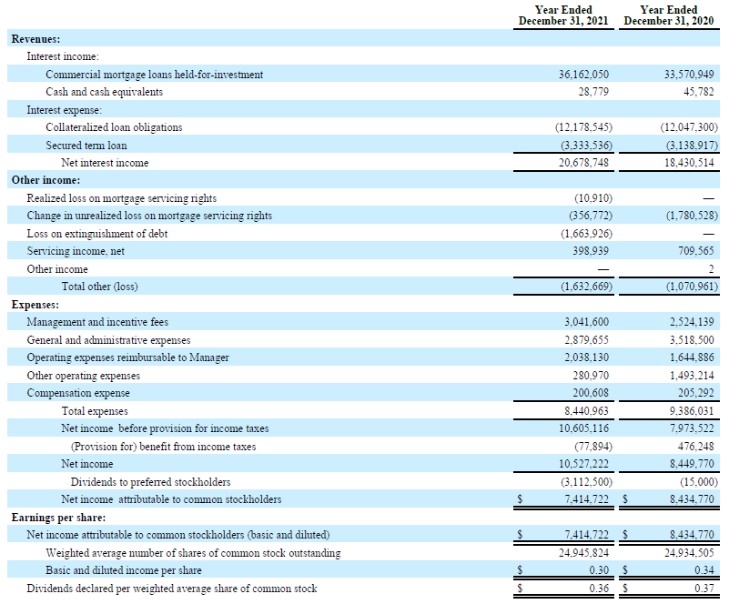
Consolidated Statement of Income

Slide 24
Reconciliation of GAAP to Distributable Earnings
 | For the Three Months Ended
GAAP to Distributable Earnings Reconciliation | December 31, 2021 | September 30, 2021 | June 30, 2021 | March 31, 2021
Reconciliation of GAAP to non-GAAP Information
Net income attributable to common stockholders | $2,478,911 | $1,176,301 | $954,575 | $2,804,935
Adjustments for non-Distributable earnings
Unrealized loss on mortgage servicing rights | 56,106 | 59,776 | 220,435 | 20,455
Purchase premium payoffs | - | 150,990 | - | -
Loss on extinguishment of debt | - | - | 1,663,926 | -
Subtotal | 56,106 | 210,766 | 1,884,361 | 20,455
Other Adjustments
Recognized compensation expense related to restricted common stock | 4,741 | 4,741 | 3,241 | 2,885
Adjustment for income taxes | 109,336 | 7,857 | (54,012) | 14,713
Subtotal | 114,077 | 12,598 | (50,771) | 17,598
Distributable Earnings | $2,649,094 | $1,399,665 | $2,788,165 | $2,842,988
Weighted average shares outstanding, basic and diluted | 24,947,883 | 24,947,883 | 24,944,075 | 24,943,383
Distributable Earnings per share of common stock, basic and diluted | $0.11 | $0.06 | $0.11 | $0.11

Slide 25
Detailed Walk of Capitalization as of 12/31/2021
(in 000's) | 12/31/2021
Total GAAP liabilities and stockholders' equity | $1,048,824
Adjustments for Capitalization
( - ) Accrued interest payable | (704)
( - ) Dividends payable | (3,243)
( - ) Fees and expenses payable to Manager | (1,825)
( - ) Other accounts payable and accrued expenses | (148)
( + ) Other capitalized financing & issuance costs | 7,872
LFT Capitalization | $1,050,776

Slide 26
Book Value Per Share of Common Stock as of 12/31/2021
(in 000's) | Book Value per Share of Common Stock
Total stockholders’ equity | $169,276
( - ) Preferred equity | (60,000)⁽¹⁾
Common equity | 109,276
Shares outstanding | 24,947,883
Book Value Per Share of Common Stock | $4.38
Note: (1) Reflects 2.4 million shares of the Company’s 7.875% Series A Cumulative Redeemable Preferred Stock outstanding at a $25 liquidation preference per share.

Slide 27
Key Definitions
“Book Value Per Share of Common Stock” is calculated as: a) total stockholders’ equity computed in accordance with GAAP less the value of the issued and outstanding preferred stock at its stated liquidation preference of $25.00 per share, divided by b) the weighted average number of shares of common stock issued and outstanding during the period, basic and diluted.
“Distributable Earnings” is a non-GAAP measure, which we define as GAAP net income (loss) attributable to holders' of common stock, or, without duplication, owners of the Company's subsidiaries, computed in accordance with GAAP, including realized losses not otherwise included in GAAP net income (loss) and excluding (i) non-cash equity compensation, (ii) incentive compensation payable to the Manager, (iii) depreciation and amortization, (iv) any unrealized gains or losses or other similar non-cash items that are included in net income for that applicable repotting period, regardless of whether such items are included in other comprehensive income (loss) or net income (loss), and (v) one-time events pursuant to changes in GAAP and certain material non-cash income or expense items after discussions with the Company's board of directors and approved by a majority of the Company's independent directors. We also add back one-time charges such as acquisition costs and one-time gains/losses on the early extinguishment of debt and redemption of preferred stock. Distributable Earnings mirrors how we calculate Core Earnings pursuant to the terms of our management agreement between our Manager and us, or our Management Agreement, for purposes of calculating the incentive fee payable to our Manager. While Distributable Earnings excludes the impact of any unrealized provisions for credit losses, any loan losses are charged off and realized through Distributable Earnings when deemed non-recoverable. Non-recoverability is determined (i) upon the resolution of a loan (i.e. when the loan is repaid, fully or partially, or in the case of foreclosures, when the underlying asset is sold), or (ii) with respect to any amount due under any loan, when such amount is determined to be non-collectible.
We believe that Distributable Earnings provides meaningful information to consider in addition to our net income (loss) and cash flows from operating activities determined in accordance with GAAP. We believe Distributable Earnings is a useful financial metric for existing and potential future holders of our common stock as historically, over time, Distributable Earnings has been a strong indicator of our dividends per share. As a REIT, we generally must distribute annually at least 90% of our taxable income, subject to certain adjustments, and therefore we believe our dividends are one of the principal reasons stockholders may invest in our common stock. Refer to Note 16 to our consolidated financial statements for further discussion of our distribution requirements as a REIT. Furthermore, Distributable Earnings help us to evaluate our performance excluding the effects of certain transactions and GAAP adjustments that we believe are not necessarily indicative of our current loan portfolio and operations, and is a performance metric we consider when declaring our dividends.
Distributable Earnings does not represent net income (loss) or cash generated from operating activities and should not be considered as an alternative to GAAP net income (loss), or an indication of GAAP cash flows from operations, a measure of our liquidity, or an indication of funds available for our cash needs. In addition, our methodology for calculating Distributable Earnings may differ from the methodologies employed by other companies to calculate the same or similar performance measures, and accordingly, our reported Distributable Earnings may not be comparable to the Distributable Earnings reported by other companies.

Slide 28
March 2022

